Slide 1
Lessons from an Unconventional Career
of 20
Notes:
Today I’m here to talk to you about my lessons from an unconventional career. How to follow your curiosity, transform your skills, and become a government innovator. I’ve been lucky, as a Foreign Service Officer, to try on many different roles – consular, political, procurement, management analyst, special assistant... But every time I tried to pick a straight career path, something else beckoned…

Slide 2
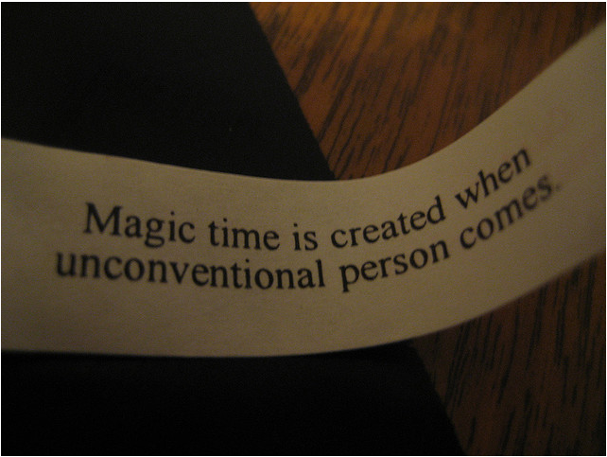
Fortune by ex.libris, on Flickr, Creative Commons
of 20
Notes:
http://www.flickr.com/photos/exlibris/1430818242/
I hope my experience will inspire you to be the unconventional magical person in the room. It’s not an easy role, it’s a necessary one. The magic happens at the multidisciplinary intersections, not the straight paths. Those intersections can pass you by, if you’re not paying attention. To catch them – you need two things: your curiosity and work-life balance.

Slide 3
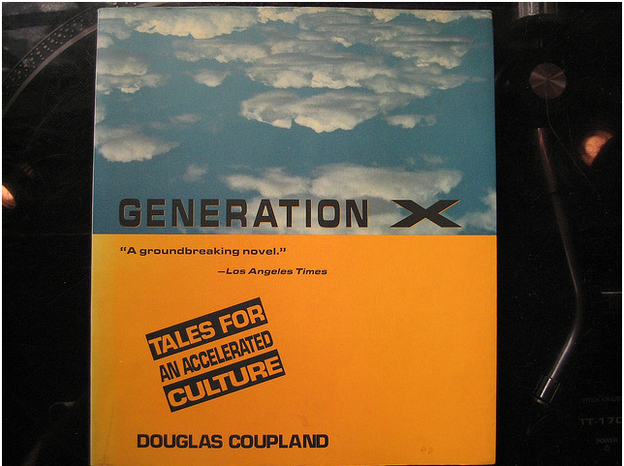
1991
2012
Generation X by Douglas Copland by Breakfast for Dinner, on Flickr
of 20
Notes:
http://www.flickr.com/photos/breakfastcore/1222785819/ Creative Commons Generation X by Douglas Copland by Breakfast for Dinner, on Flickr
When examining my career from a Gen X point of view, I feel like one characteristic that stands out precisely because I was born in 1973: Whenever I make a career move, I’m doing it on shifting ground. Some say that can make Gen X apathetic. Or it can make us more resilient and adaptable.

Slide 4
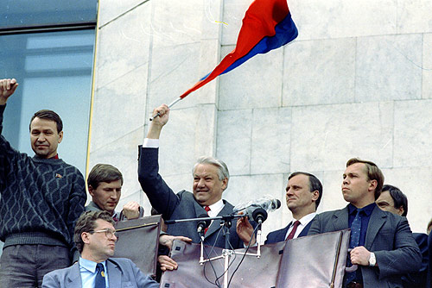
1991
1995
2001
2004
2006
2012
2005
http://www.
www.kremlin.ru
of 20
Notes:
1991 – I’m a college freshman. There’s an attempted coup in the USSR. Shortly after Gorbachev resigns, and six new countries appear. my teachers, who had been teaching the Cold War for so long, admitted they didn’t know what to teach us about international politics. That year the web makes its public debut, although it didn’t come to my school until 1995.
, in band camp – seriously – when they announced that an attempted coup had occurred in the USSR. Shortly after Gorbachev resigns, and six new countries appear. Later my teachers, who had been teaching the Cold War for so long, admitted they didn’t know what to teach us about international politics. 1991 saw the public birth of the world wide web, although it didn’t come to my school until 1995.

Slide 5
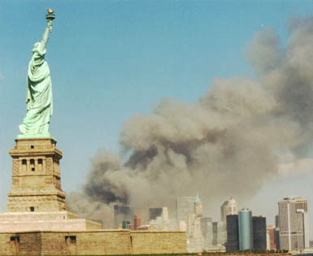
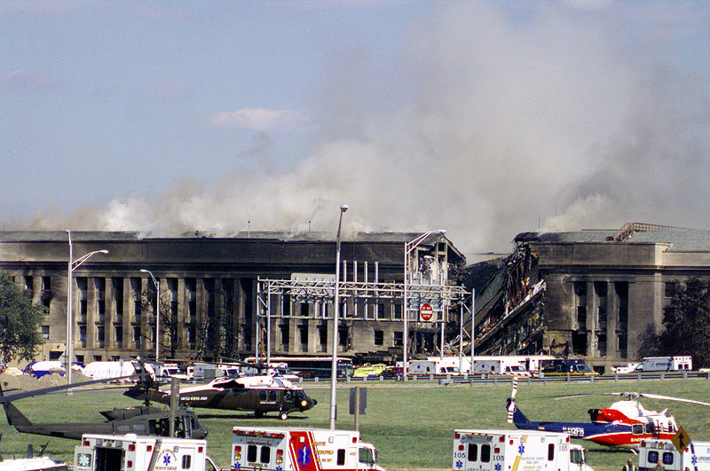
1991
1995
2001
2004
2006
2012
2005
of 20
Notes:
http://commons.wikimedia.org/wiki/File:National_Park_Service_9-11_Statue_of_Liberty_and_WTC.jpg
http://commons.wikimedia.org/wiki/File:Pentagon_on_9.11.jpg
September 10, 2001. My first day as a Foreign Service Officer. Every entry level officer is supposed to do at least one consular tour - consular officers also are the people responsible for issuing U.S. entry visas to foreigners. After 9/11, that fall we were told – we’ll teach you the consular function, but we can’t tell you how it’s going to change.
------------------------ note to self – Washington Times Quote = systems thinking ----------------------- “I think about this every day,” said Maura Harty, assistant secretary of state for consular affairs. “Since September 11, we are always looking at all of the moving parts and pieces.”
Read more: http://www.washingtontimes.com/news/2004/mar/29/20040329-011625-4149r/#ixzz2E7ofTFUK Follow us: @washtimes on Twitter

Slide 6
1991
1995
2001
2004
2006
2008
2012
2005
of 20
Notes:
http://commons.wikimedia.org/wiki/File:Facebook_icon.svg
http://commons.wikimedia.org/wiki/File:Solid_color_You_Tube_logo.png
https://twitter.com/logo
While I’m overseas, another shift starts happening – the arrival of social media on the landscape. It took a while for this shift to affect organizations. As Clay Shirky has said “Communications tools don't get socially interesting until they get technologically boring.” The Gov2.0 movement arrived 4 years later. And once again, there are no classes you can take for this.

Slide 7
of 20
Notes:
Personal photo
Meanwhile, I’m in Ghana, my first posting. As I started consular work, it wasn’t just the raison d’etre of visa policy that was unclear. What do you do when a man like this appears at your visa window? Is he a chief? Is he really? Is he rich? Is he likely to come back to Ghana? Am I the first American consular officer ask this? Why don’t we have field guide to Ghanaian culture?

Slide 8
of 20
Notes:
http://www.flickr.com/photos/kiltron/5491234424/
I was serving overseas in Morocco during the birth of social media. I was working this time as a General Services Officer, doing procurement and warehousing. What I really wanted to know was, why did we still have carbon copy work orders? Why did people still – in 2005 – have to fill out requests in triplicate? Wasn’t this automated by now?

Slide 9
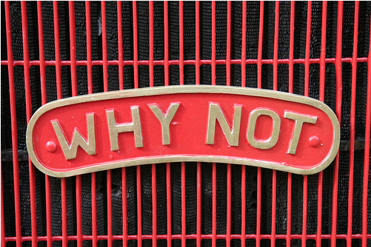
Ask
Why?
of 20
Notes:
http://www.flickr.com/photos/petereed/496392956/
And this brings me to the first lesson of an unconventional career – always ask questions. while I tortured myself and others searching for answers, overtime I realized that I was in a system. A system that was changing at different rates from the outside world. To be a part of the solution, I had to understand the system. I followed my curiosity to Washington to become a management analyst.

Slide 10
http://lorettalovehuffblog.com/
of 20
Notes:
In this job, I learned the system. I have curiosity and a voracious reading habit which helped me home-school my way into transforming my skills. In this job, I learned about IBM’s Innovation Jams. So you see, I was a girl dreaming about using social media to engage employees in problem-solving, when the opportunity to start my current program fell into my lap.

Slide 11
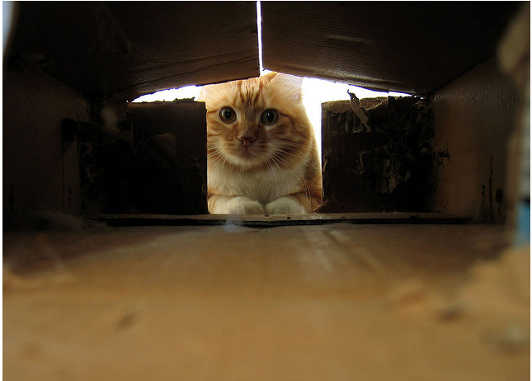
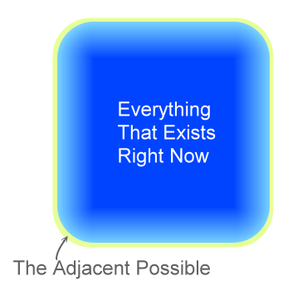
Curiosity was framed.
Avoid it at your peril. The cat's not even sick.
- Seth Godin
Peach in the box by Sunfox, on Flickr, Creative Commons
of 20
Notes:
http://www.flickr.com/photos/sunfox/6651408/
http://sethgodin.typepad.com/seths_blog/2012/09/curiosity-was-framed.html
Here’s the lesson about curiosity – it didn’t kill the cat - the cat’s not even sick. When talking innovation, everyone says that you need to “think outside of the box.” Yet research says innovation happens at the adjacent possible – what’s next to what’s here right now. Use your curiosity to figure out where the real sides of the box are. Opportunities await along those edges.

Slide 12
Passion by neil conway, on Flickr, Creative Commons
of 20
Notes:
http://www.flickr.com/photos/neilconway/3374654634/
Some people say that an unconventional career is about finding and following your passion. One writer, Cal Newport, in a Book “So Good They Can’t Ignore You,” says this is spectacularly bad advice. Instead, get good at something rare and valuable, and then leverage that for the kind of life you want to live.

Slide 13
“The important thing is not to stop questioning.
Curiosity has its own reason for existing.”
- Albert Einstein
of 20
Notes:
I say that an unconventional career is not about following your passion, as it is as much about following your curiosity AND becoming good at something rare and valuable. This is the era for the insatiably curious. Resources abound for those who want to home-school themselves in new methods, new topics, new intersections of multidisciplinary thinking.

Slide 14
Out of power 359/365 by anneh632, on Flickr, Creative Commons
of 20
Notes:
http://www.flickr.com/photos/anneh632/5868257585/ Creative Commons Out of power 359/365 by anneh632, on Flickr
There is a problem, though, with a highly interesting career – when you work long hours, take work home with you, it becomes the sum total of your personality and your sole source of feedback and gratification. Sole source contracts are frowned upon in government, and they should be in your life, too. I’m here to tell you that I’m a recovering work-aholic. I’ve been 100% burnt out.

Slide 15
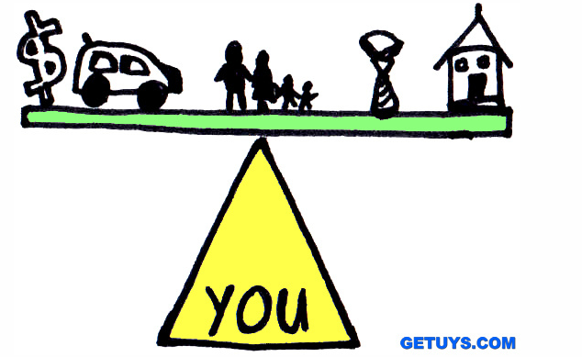
balance-your-stuff-1a--richardstep-unleash-your-strengths by RichardStep.com, on Flickr, Creative Commons
of 20
Notes:
http://www.flickr.com/photos/richardstep/7437996872/
This brings me to the second lesson: Work Life Balance. It's a paradox. It's a myth. Whatever you think about it, it’s definitely not a state you achieve, but one you constantly strive for. And it's absolutely an imperative for innovation. What we pick up from other parts of life influence how we problem-solve and invent, just like Steve Jobs did with calligraphy.

Slide 16
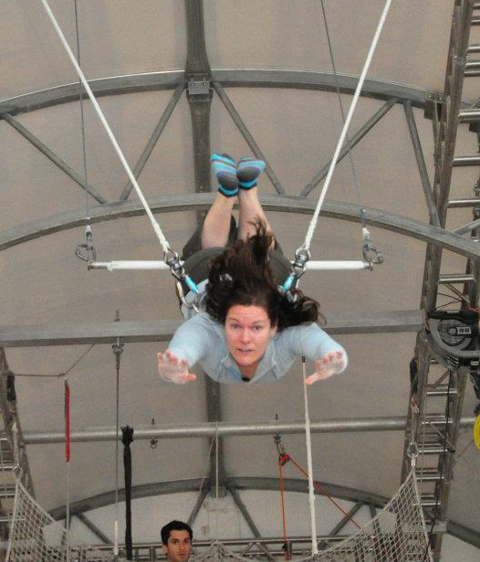
Hobbies are important.
of 20
Notes:
If you’re burnt out, you’re no good to anyone at that point – work, family, yourself. The good news is - your hobbies can save you. Rock climbing taught me problem-solving, and how to handle fear and uncertainty. Trapeze taught me about letting go, and the importance of timing. Improv taught me to accept the reality that’s given to me and run with it.

Slide 17
Values Intelligence
Emotional Intelligence
Systems Intelligence
Conscious Leadership
of 20
Notes:
This summer, I went to a Management Innovation Conference, where John Mackey, CEO of Whole Foods, spoke about Conscious Leadership. He said that 21st Century challenges require leaders who have Emotional Intelligence Spiritual or Values intelligence, and Systems Intelligence. Manage yourself, your relationships, discern purpose, see the system as a whole.

Slide 18
Values Intelligence
Emotional Intelligence
Systems Intelligence
Conscious Leadership
of 20
Notes:
This point is so important, that I’m going to double this slide. Your hobbies give you another place to practice these skills. Know yourself, in and outside work, what makes you tick? What are your strengths? Your weaknesses? What are your values? Systems intelligence – remember that box – it’s bigger and more complicated than you think. Your job is to find the edges.

Slide 19
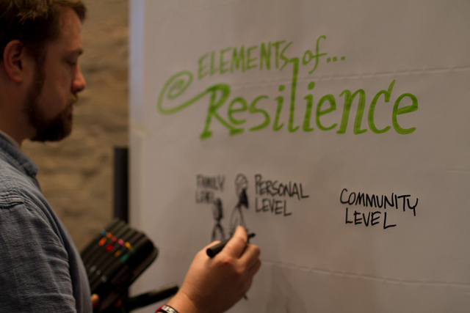
Climate Resilience Lab - Nairobi, Kenya, by poptech on flickr, creative commons
of 20
Notes:
Innovating in a bureaucracy is difficult. If your job is the sum total of your existence, you’ll crack long before the organization does. Hobbies helps build resilience. Learning how to do new things when the bureaucracy doesn’t want to helps with your own sense of self-efficacy. Resilience is also about reaching out to ask questions, to ask for help.

Slide 20
Rainbow Metal by Cosmic Kitty, on Flickr, Creative Commons
of 20
Notes:
http://www.flickr.com/photos/cosmickitty/144223623/
Here’s a quote from Sheryl Sandberg, COO of Facebook: Your career is not a ladder, it’s a jungle gym. Look for opportunities. Look for growth. Look for impact. Look for mission. Move sideways. Move down. Move on. Move off. Build your skills. Not your resume. I say, you need two things for the ride - your curiosity, and work-life balance. Everything else will follow.

Slide 21
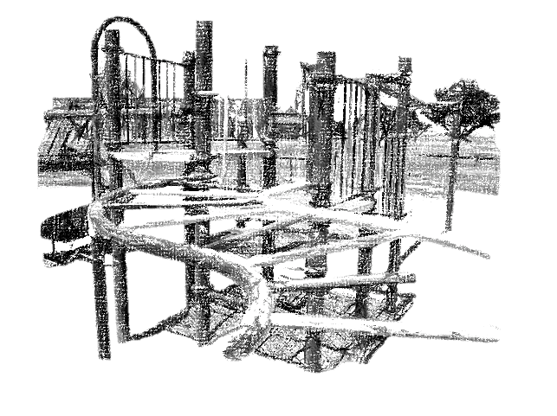
Thank you.

