Slide 1
Exploring How To Manage Up
Not quite the big-shot decision maker (yet) – but how do you lead your peers and senior officials to act?

Slide 2
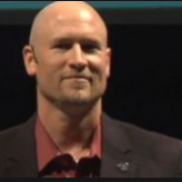
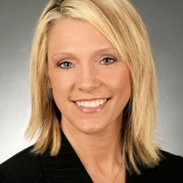
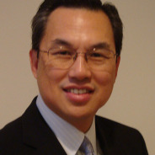
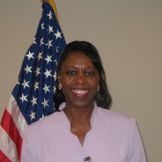
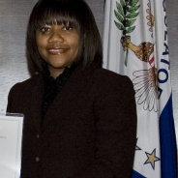
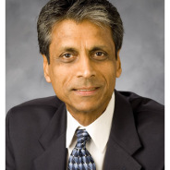
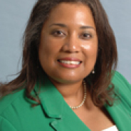
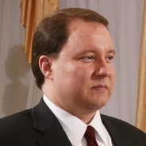
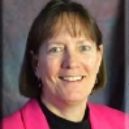
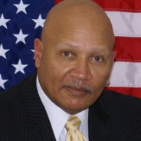
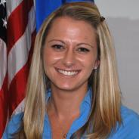
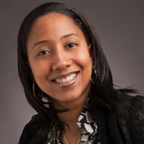
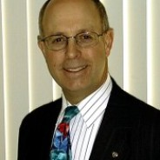
First - Let’s recap on today
Today was about connecting with like minded peers. Thinking of ways to advance your career, become a better leader, collaborator and become re-energized about your career. So, what more can I offer to tell you?
Core competencies for millennial leaders to manage up
Tell a few stories
Leave you with a challenge

Slide 3
Core Competencies for Millennial Leaders to Manage Up
Collaborators, Networkers and Connectors
Excel at Interpersonal Communications
Visionary and Innovator
Emotional Intelligence & Attuned to Present

Slide 4
Hang on - Aren’t those skills every leader needs?
Absolutely!
Leadership and management are very different things
Leaders emerge in a lot of different ways – especially for us millennials
It’s harder to lead when you’re not a manager, anyways
The key here is: Although we are all at different stages of our careers – we all can be leaders within our agency.

Slide 5
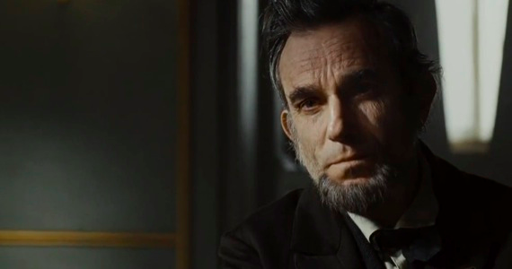
Collaboration
Notes:
John Muir.

Slide 6
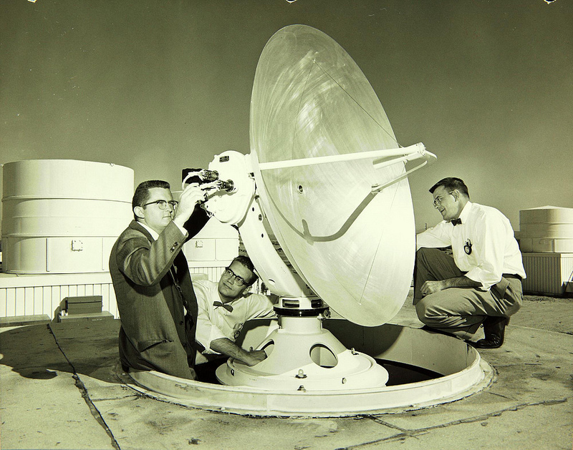
Path to PMF – Go-to resource for PMF Applicants
Communications

Slide 7
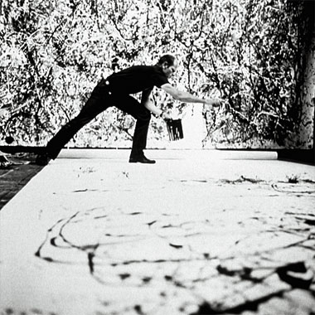
Who’s the guy with the ‘stash? Painter?

Slide 8
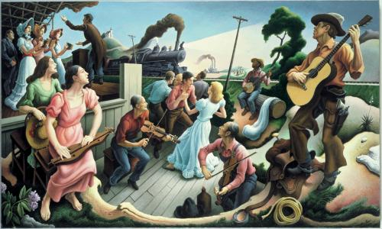
Vision and Leadership
Notes:
Pollock Number 1, 1950 (Lavendar Mist)
The Sources of Country Music

Slide 9
Final Thoughts - The Role of a Public Servant
Something engrained in those who enter public service
Call to action & build a better tomorrow
My challenge to you – why do you do what you do?
Focus on what your career goals are
What skills to do you need to develop to get there? How will you develop those?
Be proactive
Be honest with yourself, identify weakness and take some time reflecting on how you can improve.
Emotional Intelligence and Attuned to Present

Slide 10
Wrapping Up - So what are the key themes?
Leadership is twofold: a commitment to yourself to improve and a commitment to your agency/organization
Leadership is about empowering those around you to act
Leadership is not black and white, right or wrong.
Something engrained in those who enter public service
My challenge to you – why do you do what you do?

Slide 11
Contact Info
Pat Fiorenza
@pjfiorenza
pat@govloop.com

Slide 12
Exploring How To Manage Up
Not quite the big-shot decision maker (yet) – but how do you lead your peers and senior officials to act?

